Slide 1



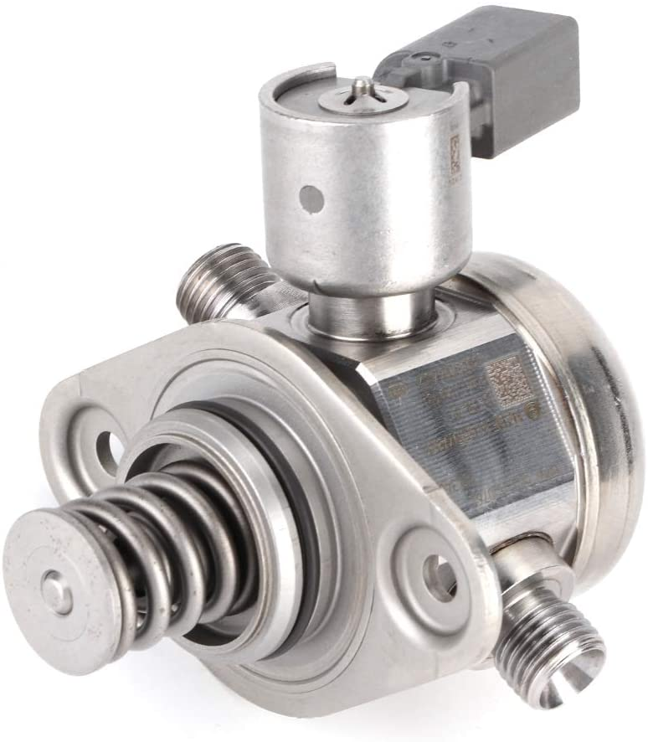
High Pressure Pump

Slide 2

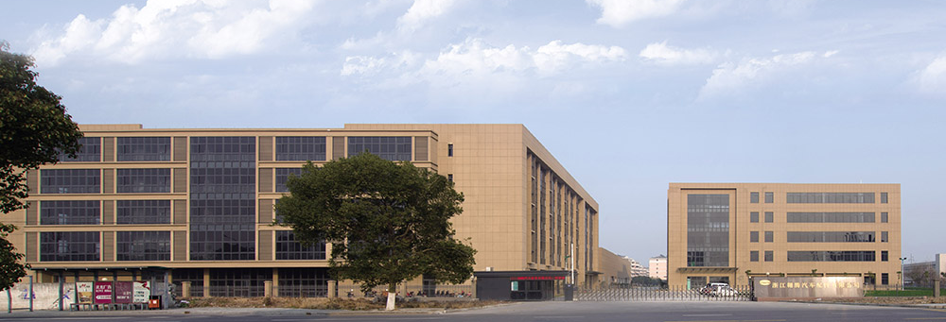
www.aoton.cn
About Aoton
ZHEJIANG AOTON INTELLIGENT TECHNOLOGY Co.,Ltd established in 2010 which is one of the professional new high-tech company Integrating research, development, production, sales and service. It is invested by Aoton Group with 20million dollars ,the registered capital is 12million dollars, it locates on Jiaxing economic development zone with 31000m2 floor space,36500m2 building area.
Based on 20 years experience and technology on manufacturing auto parts for OEM market ,OES market , and aftermarket over the world , AOTON group adapt and imported advanced production equipment ,test machine and lab. We not only implement ISO/TS 16949 quality system strictly, fully operational ERP, reasonable allocate resource, but also focus on building a high-tech research and development team, as now we already have one experienced and skilled R&D team.
The technical team formed by senior specialist ,engineers and process technician who are professional in Oil Control Valve(VVT Solenoid), Cam Phaser, GDI Pump(High Pressure Pump) , Transmission Solenoid Valve, Fuel Measurement Solenoid Valve and so on.

Slide 3
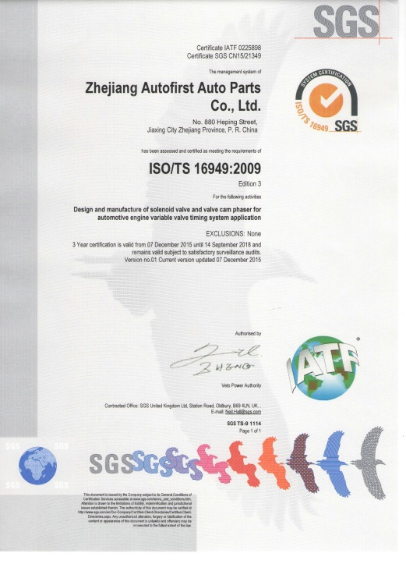
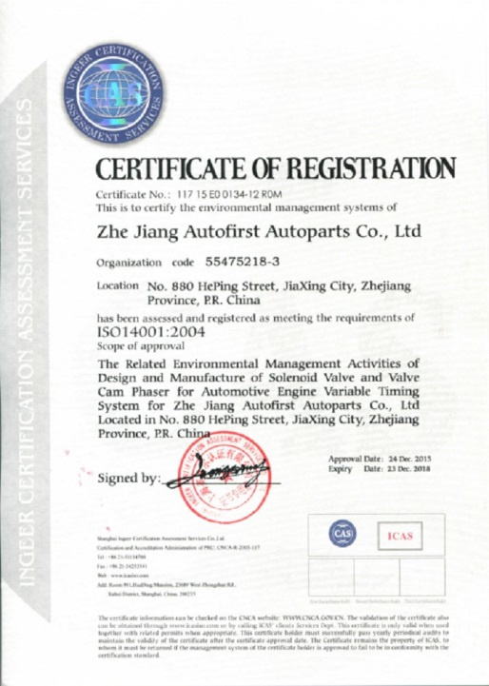
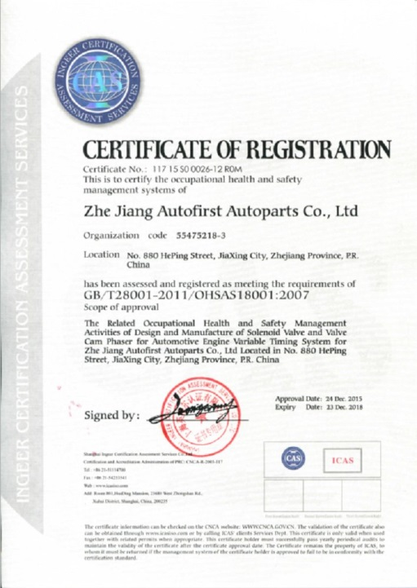
www.aoton.cn
Enterprise certification
IATF: 16949:2016
ISO: 14001:2004
ISO: 18001:2004

Slide 4
www.aoton.cn
High Pressure Pump
The high-pressure fuel pump can be customized and applied to the high-pressure common rail engine system. The product has good batch production processability, and some prototypes have reached the level of imported products.
At present, it has the ability to design, develop, batch and test all kinds of high pressure fuel pumps.

Slide 5

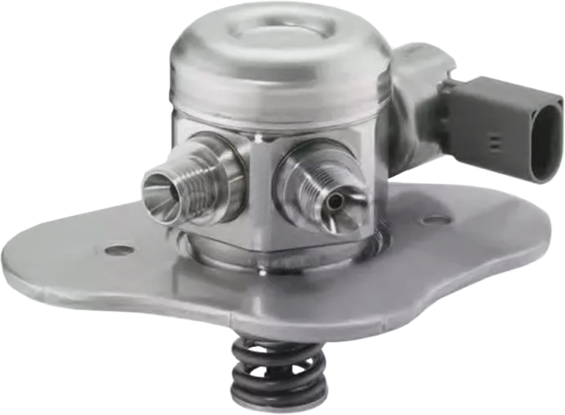
www.aoton.cn
Advantage
Product design development verification process is strictly based on SAE J2714
100% performance verification
Provides fast control valve response time
Reduce pulsation by optimizing seal shape
Increased working pressure with DLC coated plunger (longer service life)
Safety valve integration, built-in safety valve
Eliminate external leakage and minimize internal leakage.
Independent intellectual property protection

Slide 6
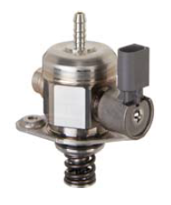
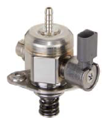
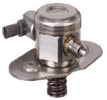
www.aoton.cn
High Pressure Pump
118600 | APPLICATION |  | CROSS REFERENCE
 | AUDI SEAT SKODA VW | AUDI A3 L4-2.0T 2008-2013 AUDI Q3 L4-2.0T 2015-2017 AUDI TT L4-2.0T 2007-2010 VOLKSWAGEN BEETLE L4-2.0T 2012-2013 VOLKSWAGEN CC L4-2.0T 2009-2017 VOLKSWAGEN EOS L4-2.0T 2011-2016 VOLKSWAGEN GTI L4-2.0T 2010-2013 VOLKSWAGEN JETTA L4-2.0T 2012-2013 VOLKSWAGEN PASSAT L4-2.0T 2010 VOLKSWAGEN GOLF L4-2.0T 2013 | OEM NO | 06H127025E, 06H127025G, 06H127025K, 06H127025M, 06H127025N, 06H127025P, 06H127025Q,06H127025R
 |  |  |  | 66809
 |  |  | BOSCH: | 0261520348 | DELPHI: | HM10011
 |  |  | SPI: | FI1508 | SMP: | GDP905
 | REMARK |  | REMARK | MASS PRODUCTION
118604 | APPLICATION |  | CROSS REFERENCE
 | AUDI SEAT SKODA VW | AUDI A1 L4-1.4T 2015-2017 AUDI A3/S3 L4-1.4T 2013-2016 AUDI A4/S4 L4-1.4T 2016-2017 AUDI Q3 L4-1.4T 2016-2017 SKODA OCTAVIA L4-1.4T 2013-2017 SKODA RAPID L4-1.4T 2013-2017 SKODA SIPERB L4-1.4T 2013-2017 SKODA YETI L4-1.4T 2013-2017 SEAT ALHAMBRA L4 1 4T 2013 2017 | OEM NO | 04E127025D,04E127026F,04E127025A, 04E127025B,04E127026AP,06G127025A
 |  |  | BOSCH: | 0261520261 | 0261520573 | 0261520339
 | REMARK |  | REMARK | Under developing
118611 | APPLICATION |  | CROSS REFERENCE
 | AUDI SEAT SKODA VW | VOLKSWAGEN BEETLE L4-1.8T 2015-2017 VOLKSWAGEN BEETLE L4-2.0T 2013-2017 VOLKSWAGEN GOLF L4-1.8T 2015-2017 VOLKSWAGEN JETTA L4-1.8T 2014-2016 VOLKSWAGEN JETTA L4-2.0T 2013-2016 VOLKSWAGEN PASSAT L4-1.8T 2014-2016 | OEM NO | 06A127026A, 06A127026B
 |  |  | BOSCH: | 0261520228 | DELPHI: | HM10049
 |  |  | SPI: | FI1527 | SMP: | GDP603
 | REMARK |  | REMARK | MASS PRODUCTION
118618 | APPLICATION |  | CROSS REFERENCE
 | BMW | BMW 550I V8-4.4L 2011-2016 BMW 550I GT V8-4.4L 2010-2017 BMW 650I V8-4 4L 2012-2017 BMW 750I V8-4.4L 2009-2015 BMW 750LI V8-4.4L 2009-2015 BMW ALPINA B7 V8-4.4L 2011-2015 BMW M5 V8-4.4L 2012-2014 BMW M6 V8-4.4L 2012-2017 BMW X5 V8-4.4L 2010-2016 BMW X6 V8-4.4L 2008-2017 | OEM NO | 13518604232, 13517599865
 |  |  | BOSCH: | 0261520294 | DELPHI: | HM10083
 |  |  | SPI: | FI1585
 | REMARK |  | REMARK | MASS PRODUCTION

Slide 7
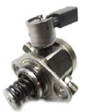
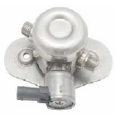
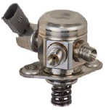
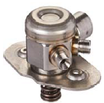
www.aoton.cn
High Pressure Pump
118619 | APPLICATION |  | CROSS REFERENCE
 | BMW | BMW 135I L6-3.0L 2012-2013 BMW 135IS L6-3.0L 2013 BMW 335I L6-3.0L 2012-2014 BMW 435I L6-3.0L 2014 BMW 535I L6-3.0L 2012-2014 BMW 535I GT L6-3.0L 2012-2013 BMW 640I L6-3.0L 2012-2014 BMW 740I L6-3.0L 2012-2014 BMW 740LI L6-3.0L 2012-2014 BMW ACTIVEHYBRID 3 L6-3.0L 2013-2014 | OEM NO | 13517610761
 |  |  |  | 0261520130
 |  |  | BOSCH: | 0261520131
 |  |  | SPI: | FI1556
 | REMARK |  | REMARK | Under developing
118620 | APPLICATION |  | CROSS REFERENCE
 | BMW | BMW I8 2014-2017 BMW X1 2016-2018 BMW X2 2018 MINI COOPER 2014-2018 MINI COOPER CLUBMAN 2016-2018 MINI COOPER COUNTRYMAN 2017-2018 | OEM NO | 13517574440
 |  |  | BOSCH: | 0261520146
 |  |  | SPI: | FI1543
 | REMARK |  | REMARK | MASS PRODUCTION
118621 | APPLICATION |  | CROSS REFERENCE
 | BMW | BMW 760LI 2010-2014 ROLLS-ROYCE GHOST 2010-2014 ROLLS-ROYCE WRAITH 2014 | OEM NO | 13517574440
 |  |  | BOSCH: | 0261520146
 |  |  | SPI: | FI1543
 | REMARK |  | REMARK | MASS PRODUCTION
118622 | APPLICATION |  | CROSS REFERENCE
 | BMW | BMW 228I 2014-2016 BMW 320I 2014-2018 BMW 328I 2012-2016 BMW 428I 2014-2016 BMW 528I 2014-2016 BMW X1 2015 BMW X3 2014-2017 BMW X4 2015-2018 BMW X5 2016 2018 | OEM NO | 13517640055, 13518604229
 |  |  | BOSCH: | 0261520282 | DELPHI: | HM10074
 |  |  | SPI: | FI1583
 | REMARK |  | REMARK | Under developing

Slide 8
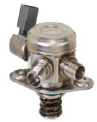
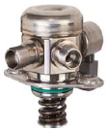
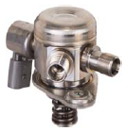
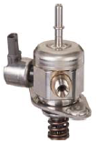
www.aoton.cn
High Pressure Pump
118626 | APPLICATION |  | CROSS REFERENCE
 | BMW | MERCEDES-BENZ CL63 AMG 2011-2014 MERCEDES-BENZ CLS63 AMG 2012-2014 MERCEDES-BENZ CLS63 AMG S 2014 MERCEDES-BENZ E63 AMG 2012-2014 MERCEDES-BENZ G63 AMG 2013-2014 MERCEDES-BENZ GL450 2013-2014 MERCEDES-BENZ GL550 2013-2014 MERCEDES-BENZ GL63 AMG 2013-2014 MERCEDES-BENZ ML550 2012-2014 MERCEDES-BENZ ML63 AMG 2012-2014 | OEM NO | 2780700601, A2780700601,2780701201
 |  |  | BOSCH: | 0261520119 | DELPHI | HM10089
 |  |  | SPI: | FI1559
 | REMARK |  | REMARK | Under developing
118627 | APPLICATION |  | CROSS REFERENCE
 | MERCEDES -BENZ | MERCEDES-BENZ CL550 2011-2014 MERCEDES-BENZ CL63 AMG 2011-2014 MERCEDES-BENZ CLS550 2012-2014 MERCEDES-BENZ CLS63 AMG 2012-2014 MERCEDES-BENZ CLS63 AMG S 2014 MERCEDES-BENZ E550 2012-2014 MERCEDES-BENZ E63 AMG 2012-2014 MERCEDES-BENZ GL450 2013-2014 MERCEDES-BENZ GL550 2013-2014 MERCEDES-BENZ G63 AMG 2013-2014 | OEM NO | 2780700101, 2780701101, A2780700101
 |  |  | BOSCH: | 0261520058 | DELPHI | HM10090
 |  |  | SPI: | FI1561
 | REMARK |  | REMARK | MASS PRODUCTION
118628 | APPLICATION |  | CROSS REFERENCE
 | MERCEDES -BENZ | MERCEDES-BENZ C300 2013-2014 MERCEDES-BENZ C350 2012-2015 MERCEDES-BENZ E350 2012-2016 MERCEDES-BENZ E400 2013-2015 MERCEDES-BENZ GLE350 2016-2018 MERCEDES-BENZ GLK350 2013-2015 MERCEDES-BENZ ML350 2012-2015 MERCEDES-BENZ R350 2012 MERCEDES-BENZ SLK350 2012-2016 | OEM NO | 2760700101, 2760700601, A2760700101
 |  |  | BOSCH: | FI1553062 | DELPHI | HM10000
 |  |  | SPI: | FI1553
 | REMARK |  | REMARK | MASS PRODUCTION
118629 | APPLICATION |  | CROSS REFERENCE
 | BMW | MINI COOPER 2012-2014 MINI COOPER COUNTRYMAN 2012-2014 MINI COOPER PACEMAN 2013-2014 | OEM NO | 13518605102, 13517630644
 |  |  | BOSCH: | 0261520290 | DELPHI: | HM10080
 |  |  | SPI: | FI1582
 | REMARK |  | REMARK | Under developing

Slide 9
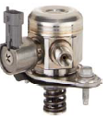
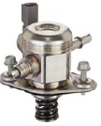
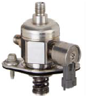
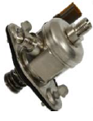
www.aoton.cn
High Pressure Pump
118630 | APPLICATION |  | CROSS REFERENCE
 | GM | BUICK REGAL 2011-2013 BUICK VERANO 2013-2016 CHEVROLET COBALT 2008-2010 CHEVROLET HHR 2008-2010 PONTIAC SOLSTICE 2007-2009 SAAB 9-5 2011 SATURN SKY 2007-2010 | OEM NO | 12589448, 12614737, 12625764, 12629135, 12646884, 12658478
 |  |  | BOSCH: | 0261520296 | DELPHI: | HM10029
 |  |  | SPI: | FI1532 | SMP: | GDP101
 | REMARK |  | REMARK | MASS PRODUCTION
118631 | APPLICATION |  | CROSS REFERENCE
 | GM | BUICK REGAL 2014 2017 CHEVROLET IMPALA 2014-2017 CHEVROLET MALIBU 2013-2015 CHEVROLET MALIBU LIMITED 2016 | OEM NO | 12651170, 12658481
 |  |  | BOSCH: | 0261520298 | DELPHI: | HM10075
 |  |  | SPI: | FI1521 | SMP: | GDP104
 | REMARK |  | REMARK | MASS PRODUCTION
118632 | APPLICATION |  | CROSS REFERENCE
 | GM | BUICK ALLURE 2010 BUICK ENCLAVE 2009-2017 BUICK LACROSSE 2010-2011 CADILLAC CTS 2008-2011 CADILLAC STS 2008-2011 CHEVROLET CAMARO 2010-2011 CHEVROLET TRAVERSE 2009-2017 GMC ACADIA 2009-2016 GMC ACADIA LIMITED 2017 SATURN OUTLOOK 2009-2010 | OEM NO | 12614934, 12626234, 12634492, 12639260, 12647344, 12658552, 12676667
 |  |  | BOSCH: | 0261520302 | DELPHI: | HM10010
 |  |  | SPI: | FI1507 | SMP: | GDP102
 | REMARK |  | REMARK | MASS PRODUCTION
118637 | APPLICATION |  | CROSS REFERENCE
 | GM | CADILLAC ATS 2016-2017 CADILLAC CTS 2016-2017 CHEVROLET CAMARO 2016-2017 | OEM NO | 12651339, 12672145, 12676414
 |  |  | BOSCH: | 0261520519 | DELPHI: | HM10112
 |  |  |  |  | SMP: | GDP110
 | REMARK |  | REMARK | Under developing

Slide 10
www.aoton.cn
High Pressure Pump
118630 | APPLICATION |  | CROSS REFERENCE
 | GM | BUICK REGAL 2011-2013 BUICK VERANO 2013-2016 CHEVROLET COBALT 2008-2010 CHEVROLET HHR 2008-2010 PONTIAC SOLSTICE 2007-2009 SAAB 9-5 2011 SATURN SKY 2007-2010 | OEM NO | 12589448, 12614737, 12625764, 12629135, 12646884, 12658478
 |  |  | BOSCH: | 0261520296 | DELPHI: | HM10029
 |  |  | SPI: | FI1532 | SMP: | GDP101
 | REMARK |  | REMARK | MASS PRODUCTION
118631 | APPLICATION |  | CROSS REFERENCE
 | GM | BUICK REGAL 2014 2017 CHEVROLET IMPALA 2014-2017 CHEVROLET MALIBU 2013-2015 CHEVROLET MALIBU LIMITED 2016 | OEM NO | 12651170, 12658481
 |  |  | BOSCH: | 0261520298 | DELPHI: | HM10075
 |  |  | SPI: | FI1521 | SMP: | GDP104
 | REMARK |  | REMARK | MASS PRODUCTION
118632 | APPLICATION |  | CROSS REFERENCE
 | GM | BUICK ALLURE 2010 BUICK ENCLAVE 2009-2017 BUICK LACROSSE 2010-2011 CADILLAC CTS 2008-2011 CADILLAC STS 2008-2011 CHEVROLET CAMARO 2010-2011 CHEVROLET TRAVERSE 2009-2017 GMC ACADIA 2009-2016 GMC ACADIA LIMITED 2017 SATURN OUTLOOK 2009-2010 | OEM NO | 12614934, 12626234, 12634492, 12639260, 12647344, 12658552, 12676667
 |  |  | BOSCH: | 0261520302 | DELPHI: | HM10010
 |  |  | SPI: | FI1507 | SMP: | GDP102
 | REMARK |  | REMARK | MASS PRODUCTION
118637 | APPLICATION |  | CROSS REFERENCE
 | GM | CADILLAC ATS 2016-2017 CADILLAC CTS 2016-2017 CHEVROLET CAMARO 2016-2017 | OEM NO | 12651339, 12672145, 12676414
 |  |  | BOSCH: | 0261520519 | DELPHI: | HM10112
 |  |  |  |  | SMP: | GDP110
 | REMARK |  | REMARK | Under developing

Slide 11
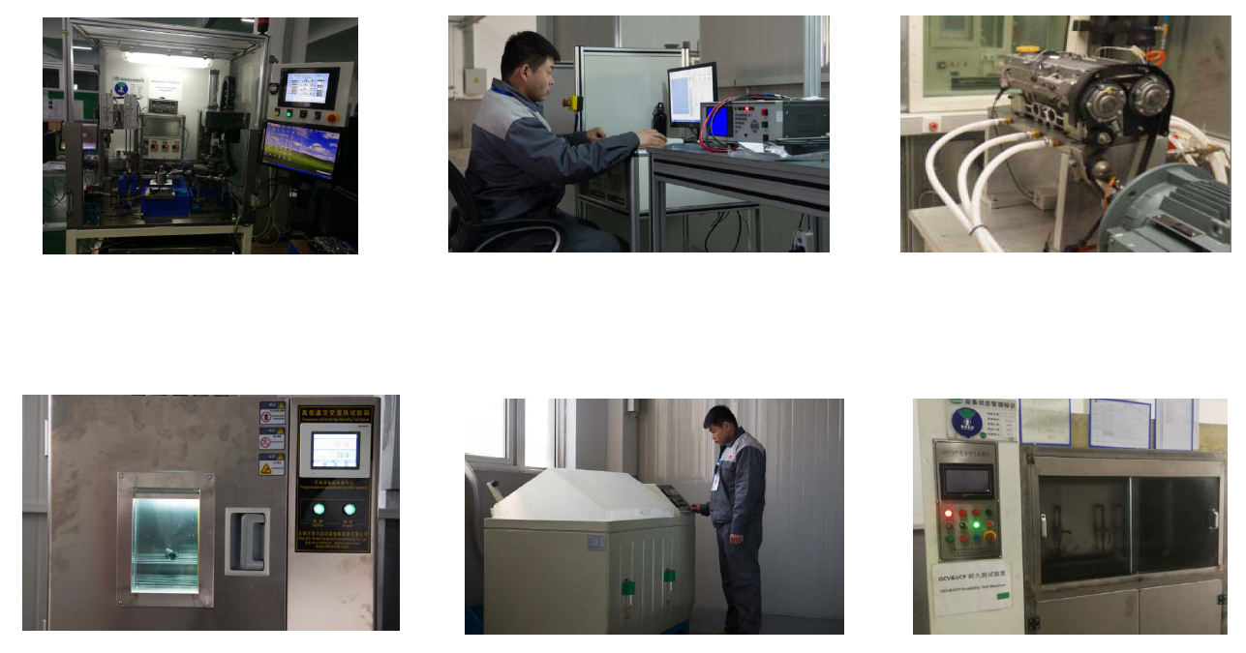
www.aoton.cn
Laboratory equipment
Comprehensive Performance Testing
EMC Testing
Engine simulator
Testing extreme low and high working temperatures
Chemical and aerosol testing
Durability tests

Slide 12
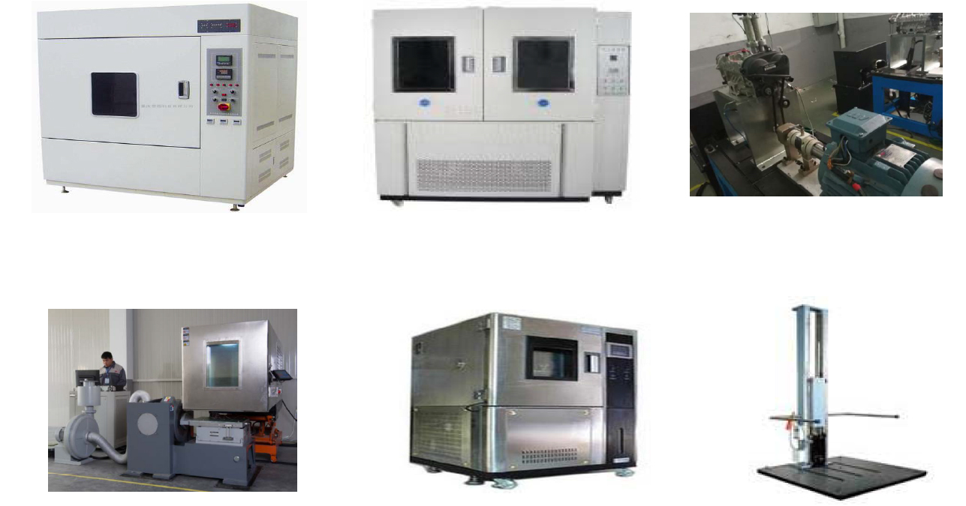
www.aoton.cn
Лабораторное оборудование
Testing for various weather conditions
Dust test
Spring Durability Test
Combined Environmental Resistance Test
Temperature and humidity chamber
Drop test

Slide 13
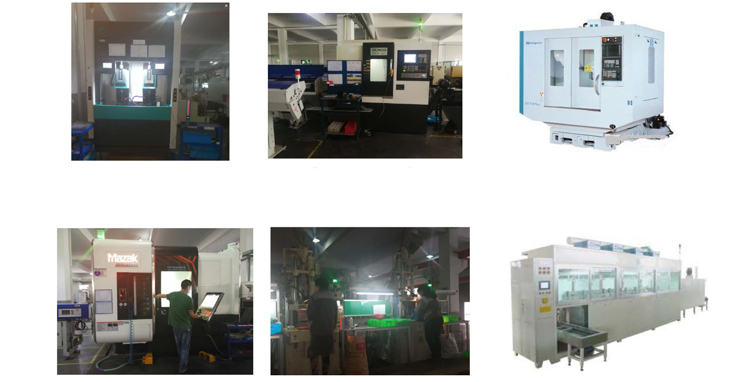
www.aoton.cn
Production equipment
Grinding machine
5 sets
Precision CNC Lathe
16 Sets
Machining center
10 sets
CNC machine
30 sets
Injection molding
16 sets
Automated Ultrasonic Cleaning Machine

Slide 14
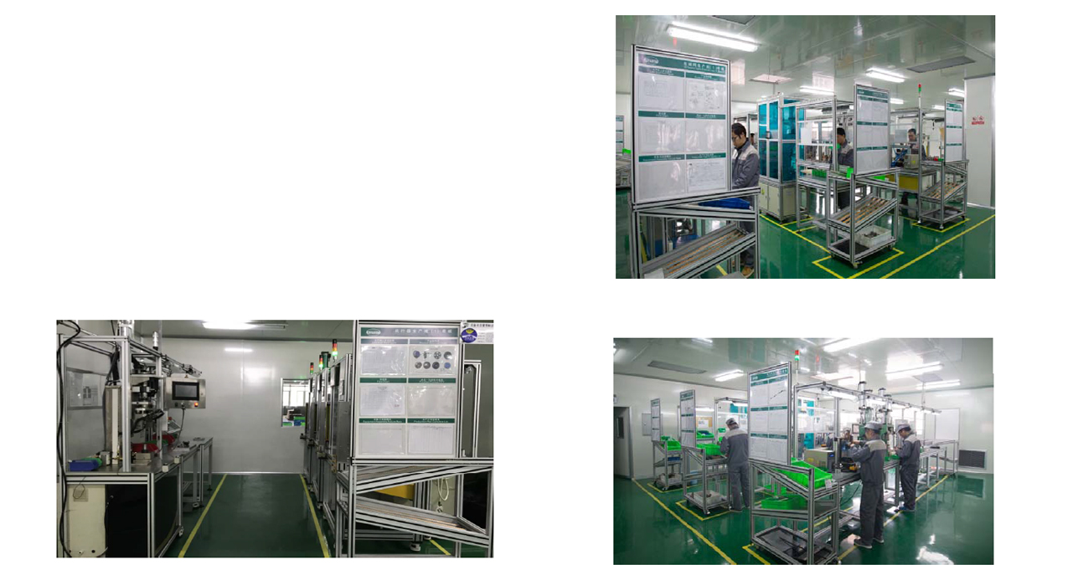

www.aoton.cn
Assembly center
Assembly lines. 6 main criteria:
Own design in accordance with the nature of the original
Custom values
Foolproof and no alarm
Statistical Data Analysis
Computer automatic data is stored
100% line performance test

Slide 15
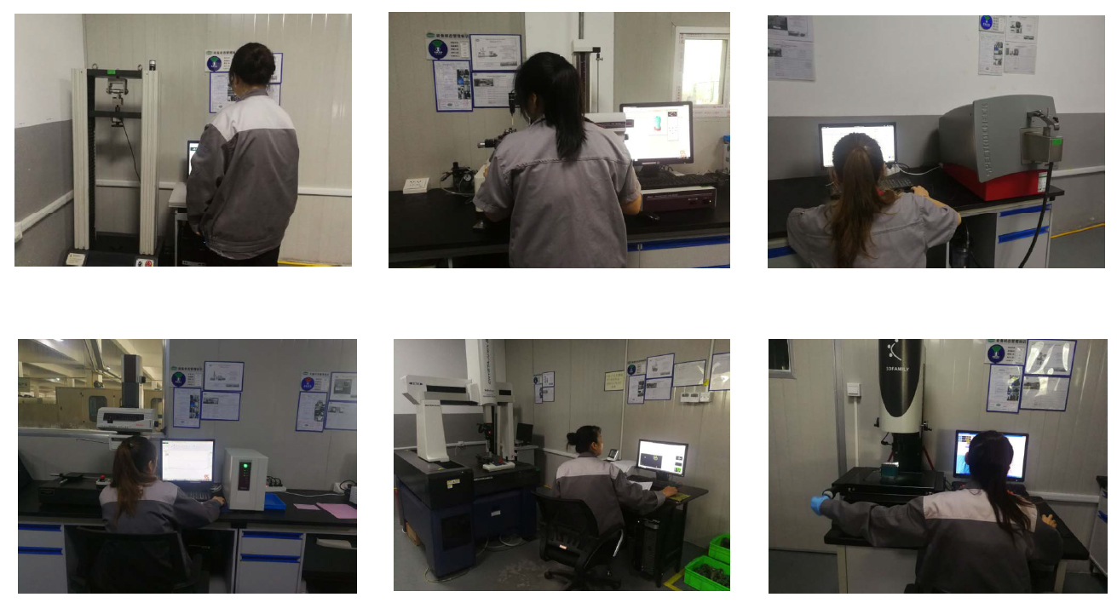
www.aoton.cn
Measuring equipment
Tensile test
Roundness tester Mitutoyo
Spike spectrometer
Profile Tester Mitutoyo
Triaxial Mitutoyo test
Image measuring device

Slide 16
www.aoton.cn
Quality control
Supplier selection.
Supplier Process Management
Input control
Online production line inspection (flowchart)
Line performance test (100%)
First Inspection Article
Self control
Routing check
Instrumental error protection.
Error switch

Slide 17
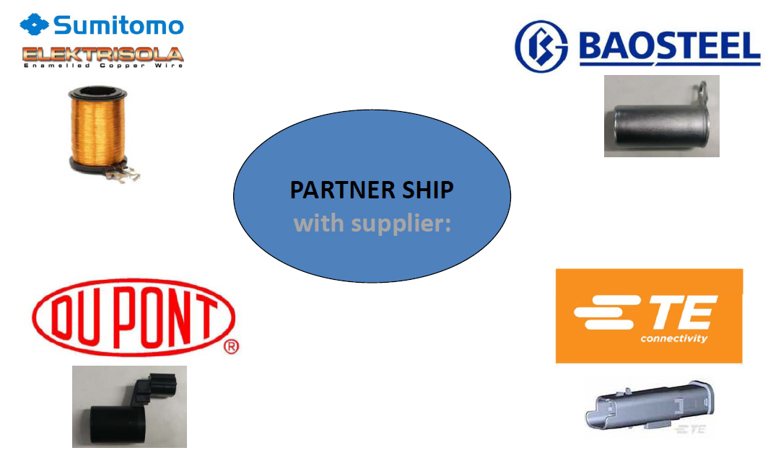
www.aoton.cn
Suppliers
The suppliers of key components are proven large international companies.

Slide 18
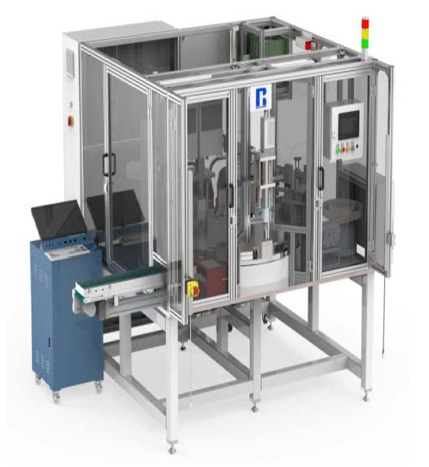
www.aoton.cn
Final Test Branch
The testing process is fully automated.
Test medium - engine oil with constant temperature control system.
With dynamic high sensitivity and high precision pressure sensor. The built-in error in the response time of the equipment is less than 0.1 ms.
Collects and stores pressure response time curve, current and voltage curve and other data.
Automatic oil removal and labeling.
Inappropriate product is screened out.

Slide 19

www.aoton.cn
Export
AOTON is exported to many countries of the world:
20% - China
35% - North America
25% - Europe
15% - South America

Slide 20


